Slide 1

Department of Mechanical Engineering
Experimental and Theoretical Characterization of Acoustically Perturbed Inkjet Mixtures Using High-Speed Imaging and Numerical Modeling
Roll No | Name
CB.EN.U4MEE22116 | DHAYANITHI J
CB.EN.U4MEE22120 | HARISAKTHI K N
CB.EN.U4MEE22138 | RITHVIK R
CB.EN.U4MEE22146 | SHUSHIL A
Guided By | Dr. K Balaji
Group No
5
Notes:
Good afternoon everyone I am Devesh, and my team members are Ghukan, Pranavi and Mohanram. Our project guide is Dr. Balaji K, Associate Professor, Department of Mechanical Engineering. The project title is Exploring the Breakup Morphology of Single, Twin, and Multi-Jet Systems by shearing – A Numerical and Experimental Approach

Slide 2
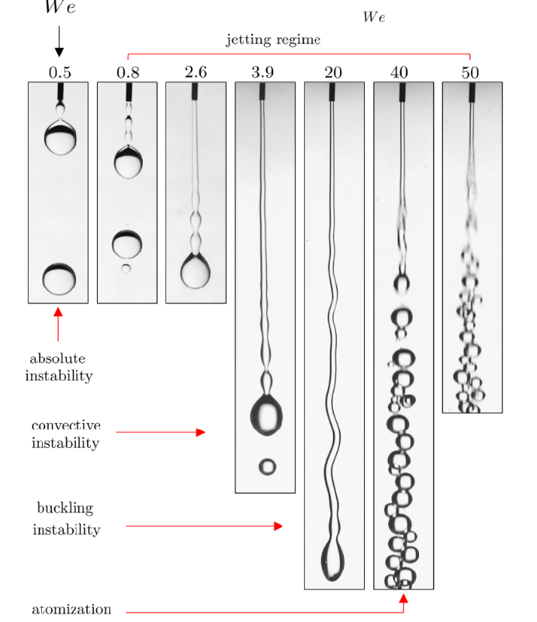

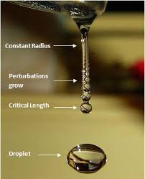
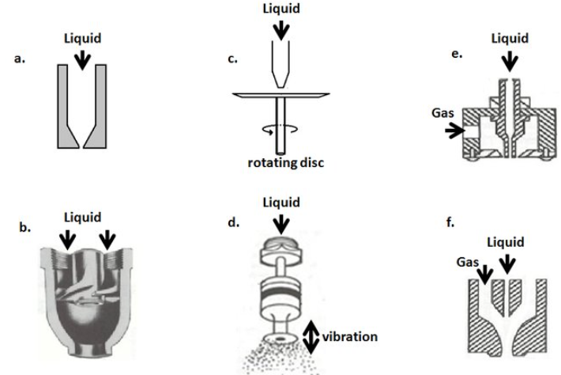
Atomization vs Droplet Generation
Breakup Regimes
Atomization
Chaotic, high-speed breakup into fine droplets.
Droplet Generation
Controlled breakup into discrete droplets
Atomizers - Configurations
A. Lefebvre and D.R. Ballal. "Breakup of liquid jets and the formation of droplets" (2010).
Atomization and Sprays - Lefebvre
Notes:
I will give a brief introduction about atomization, flow configuration and different breakup regimes. Atomization is the process of disintegration of bulk liquid into fine sprays by utilizing its own kinetic energy or by applying external forces. Different flow configurations are shown which includes both passive and active control strategies. Liquid jet break phenomenon is classified into five different regimes based on the gas Weber number named as Dripping, Rayleigh breakup, first wind induced, second wind induced and atomization. The present study focuses on Second wind induced zone and atomization zone. Atomization process plays a major role in many industrial application. They are are discussed in the next slide by Ghukan.

Slide 3
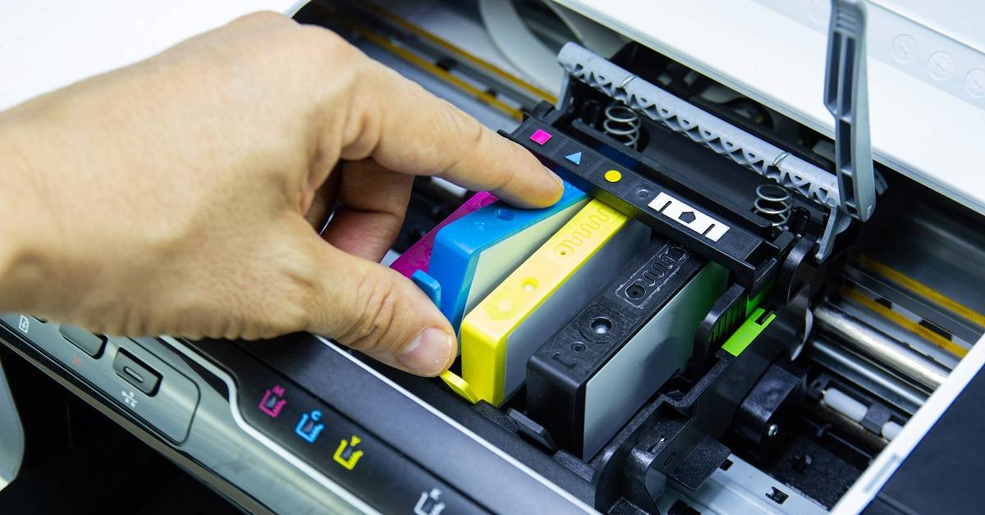
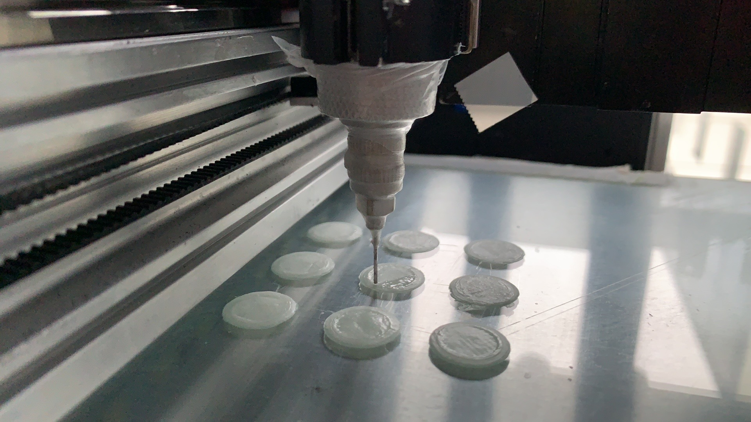
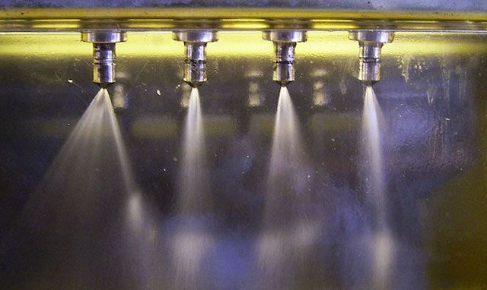

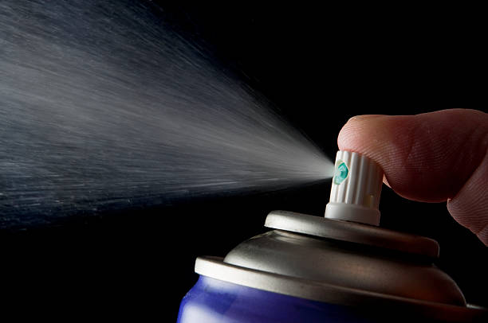
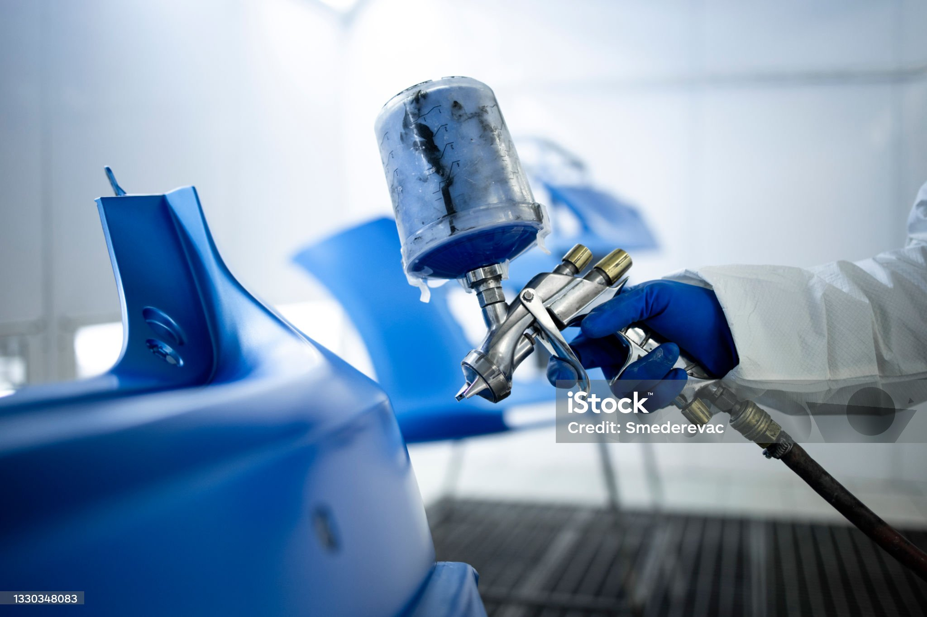
APPLICATIONS
Impact on Sustainable Development Goals (SDGs)
SDG 9 (Industry, Innovation, and Infrastructure):
Promotes sustainable industrial processes and technological innovation.
SDG 12 (Responsible Consumption and Production):
Reduces material waste and enhances resource efficiency in manufacturing.
INKJET PRINTER
PHARMACEUTICAL
COMBUSTION
AGRICULTURE
AEROSOLS
SPRAY COATING

Slide 4
Problem Statement
Existing inkjet studies lack focus on acoustic perturbation effects in fluid breakup.
Complex fluids like ethylene glycol, glycerol, and propylene glycol behave differently than simple Newtonian fluids.
Breakup mechanisms (ligament, droplet, satellite) under acoustic influence are not well understood.
Current numerical models fail to accurately predict behavior of acoustically excited inkjet mixtures.
There's limited experimental data using high-speed imaging for such perturbed inkjet flows.
A combined experimental and theoretical approach is needed to characterize these dynamics.

Slide 5
S.No. | Author(s) & Year | Title | Methodology | Key Findings | Research Gap
1 | Dong et al., 2006 | Controllable Printing Droplets on Demand by Piezoelectric Inkjet: Applications and Methods | Experimental and theoretical analysis of piezoelectric droplet generation | Showed effective control of droplet formation by tuning waveform and fluid parameters | Lack of insight on transient fluid dynamics in complex fluids
2 | Priya et al., 2007 | Acoustically Activated Nozzle for Microdroplet Generation and Dispensing | Acoustic resonance with piezoelectric excitation | Demonstrated precise droplet control using acoustic energy | Lacks scalability and integration with existing printing systems
3 | Wang et al., 2018 | Deformation Characteristics of a Single Droplet Driven by a Piezoelectric Nozzle | Experimental high-speed imaging and CFD simulation | Capillary number affects deformation significantly; maximum observed at Ca ≈ 0.75 | Limited application to complex or high-viscosity fluids

Slide 6
S.No. | Author(s) & Year | Title | Methodology | Key Findings | Research Gap
4 | Wijshoff et al., 2013 | Piezo-Actuated Microdroplet Generator Design & Fabrication | MEMS design, microfabrication, and testing | Achieved highly accurate droplet size control via actuator optimization | Scalability and high-frequency performance not fully tested
5 | Satheesh et al., 2020 | Simulating Microfluidic Flow Focusing Droplet Generation Under Surface Tension, Geometric, and Adhesive Variation, and Refining Dynamic Simulated Adhesion | Numerical simulation (CFD) including surface adhesion variation | Highlighted the role of wettability and adhesion in droplet breakup | Experimental validation and multi-physics coupling are lacking
6 | Hybrid Design Team, 2024 | Hybrid Printhead Combining Piezoelectric + EHD for Viscous Inks | CFD simulations on coupled actuation | Enabled droplet formation in high-viscosity fluids via EHD-piezo synergy | Experimental prototyping and integration remain incomplete

Slide 7
Research gaps
Optimization of Nozzle Design Parameters
Lack of comprehensive CFD-based parametric studies linking fluid properties, nozzle geometry, and actuation strategies.
Limited testing of high-frequency actuator performance under acoustic excitation for consistent droplet generation.
2. Enhancing Droplet Formation Control
Absence of empirical correlations capturing the effects of acoustic parameters on droplet size and timing.
Insufficient modeling of droplet breakup dynamics in non-Newtonian or multi-component ink systems.
3. Addressing Experimental Validation and Integration
Most simulations lack validation with high-speed imaging and real-ink experimental data.
Integration and scalability of acoustically actuated systems with industrial printheads remain underexplored.

Slide 8
Objectives
Modes of Droplet Breakup under Acoustic Perturbation | : | Study of ligament and point-source breakup modes in inkjet jets with and without acoustic excitation using externally applied sound waves.
Qualitative Measurement | : | Visual analysis of breakup behavior under varying acoustic frequencies and waveforms Observation of satellite droplets, ligament thinning, and detachment dynamics using high-speed imaging
Quantitative Measurement | : | Development of empirical correlation relating breakup characteristics with acoustic input parameters: Frequency, waveform shape, and amplitude Fluid viscosity, density, and surface tension
Stability Parameters | : | Integrated Variables Droplet size distribution Breakup distance from the nozzle Intrinsic Variables Breakup frequency Critical acoustic pressure for stable ejection Droplet velocity and Weber number variation

